Slide 1
Database Systems
TextB Ch2: Intro to Relational Model
吴汉瑞 , 副教授 Hanrui Wu, Associated Professor
Email: wuhanrui@jnu.edu.cn
Research area: machine learning, artificial intelligence
Contact me if you are interested in research or would like to be my postgraduate

Slide 2
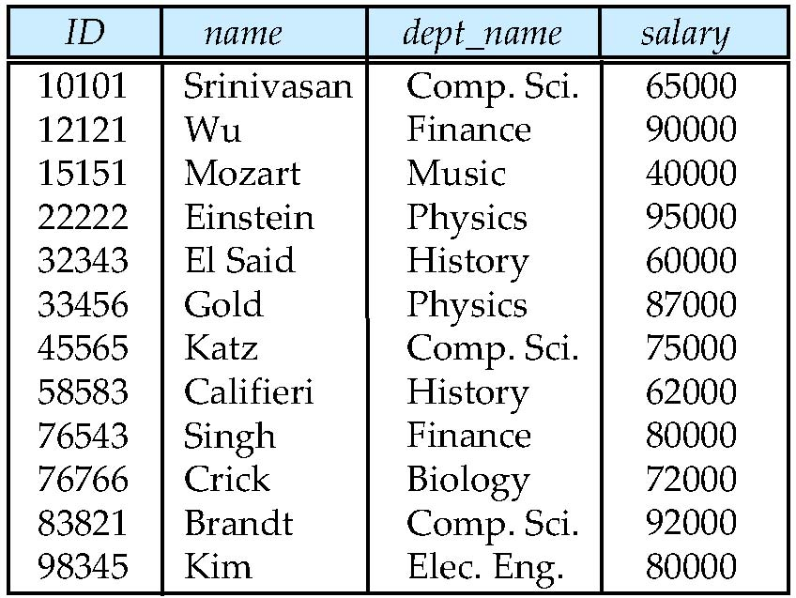
Example of a Relation
Fig. 2.1 The instructor relation (table)
attributes
(or columns,
or fields)
tuples
(or rows,
or records)

Slide 3
Attribute Types
The set of allowed values for each attribute is called the domain of the attribute
Attribute values are (normally) required to be atomic; that is, indivisible
The special value null is a member of every domain
The null value causes complications in the definition of many operations

Slide 4
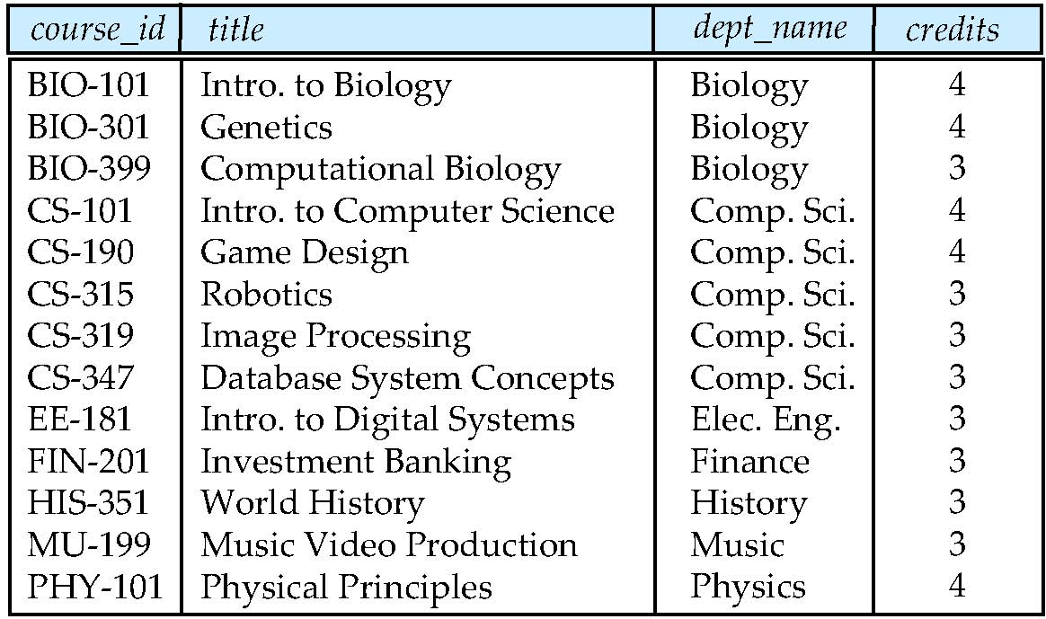
Fig. 2.2 The course relation

Slide 5
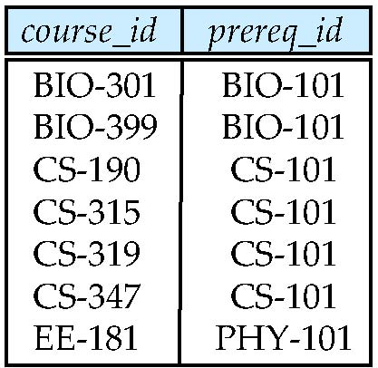
Fig. 2.3 The prereq relation

Slide 6
Relation Schema and Instance
A₁, A₂, …, A_{n} are attributes
R = (A₁, A₂, …, A_{n} ) is a relation schema
Example:
instructor = (ID, name, dept_name, salary)
Formally, given sets D₁, D₂, …. D_{n} a relation r is a subset of D₁ x D₂ x … x D_{n} Thus, a relation is a set of n-tuples (a₁, a₂, …, a_{n}) where each a_{i} ∈ D_{i}
The current values (relation instance) of a relation are specified by a table
An element t of r is a tuple, represented by a row in a table

Slide 7
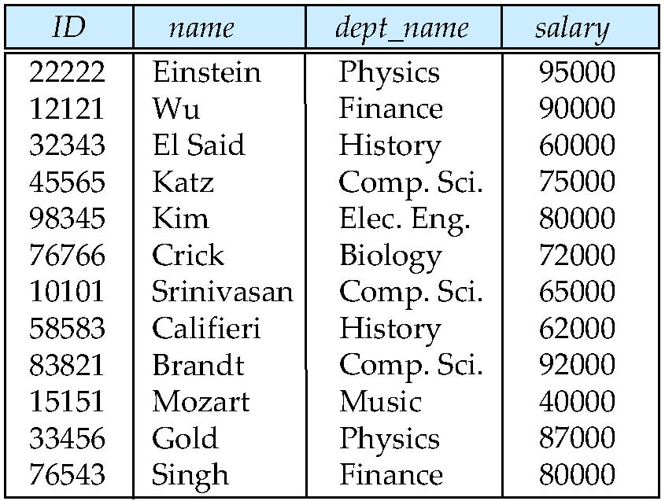
Relations are Unordered
Order of tuples is irrelevant (tuples may be stored in an arbitrary order)
Example: instructor relation with unordered tuples (Fig. 2.4)

Slide 8
Database
A database consists of multiple relations
Information about an enterprise is broken up into parts
instructor student advisor
Bad design: univ (instructor -ID, name, dept_name, salary, student_Id, ..) results in
repetition of information (e.g., two students have the same instructor)
the need for null values (e.g., represent an student with no advisor)
Normalization theory (Chapter 7) deals with how to design “good” relational schemas

Slide 9
Keys
Let K ⊆ R
K is a superkey of R if values for K are sufficient to identify a unique tuple of each possible relation r(R)
Example: {ID} and {ID,name} are both superkeys of instructor.
Superkey K is a candidate key if K is minimal Example: {ID} is a candidate key for Instructor
One of the candidate keys is selected to be the primary key.
which one?
Foreign key constraint: Value in one relation must appear in another
Referencing relation
Referenced relation

Slide 10
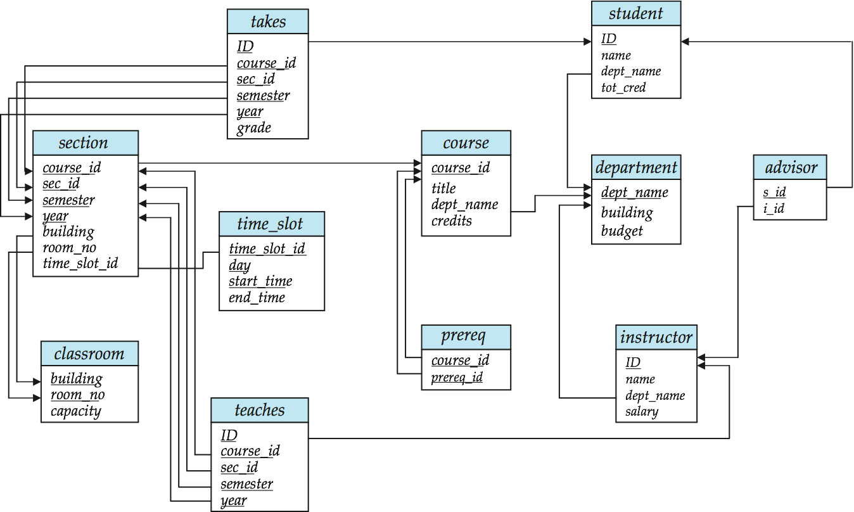
Schema Diagram for University Database (Fig 2.8)

Slide 11
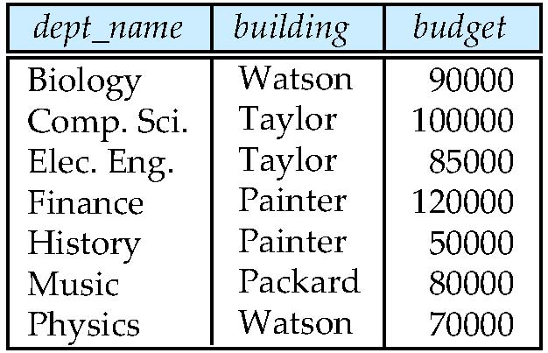
Fig 2.5 The department relation

Slide 12
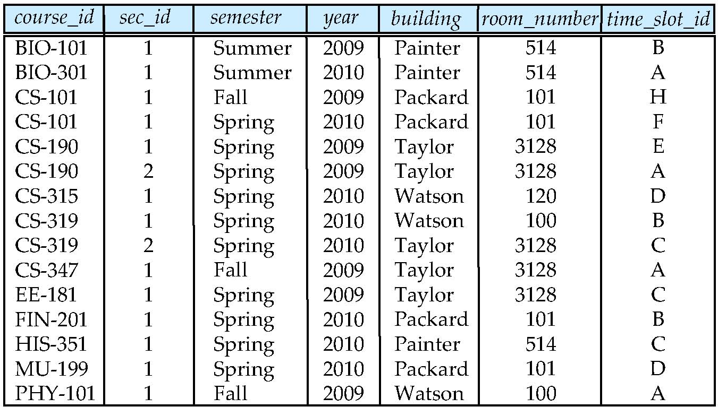
Fig. 2.6 The section relation

Slide 13
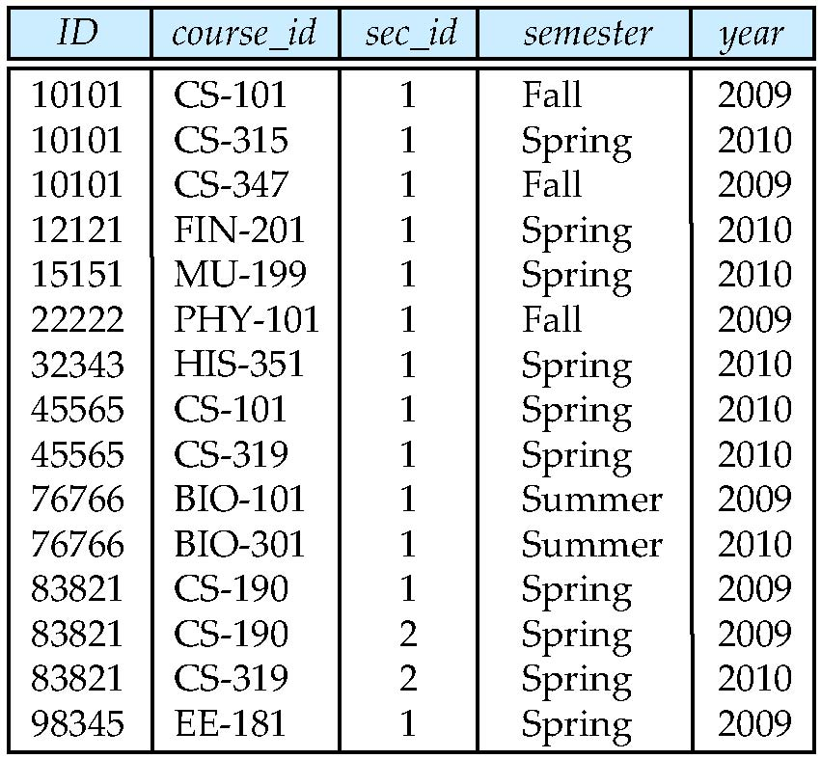
Fig. 2.7 The teaches relation

Slide 14
Relational Query Languages
Procedural vs.non-procedural, or declarative
“Pure” languages:
Relational algebra
Tuple relational calculus
Domain relational calculus
Relational operators

Slide 15
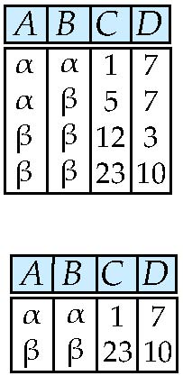
Selection of tuples
Relation r
Select tuples with A=B and D > 5
σ _{A=B and D > 5} (r)

Slide 16
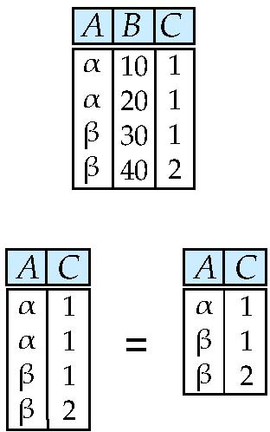
Selection of Columns (Attributes)
Relation r:
Select A and C
Projection
Π _{A, C} (r)

Slide 17
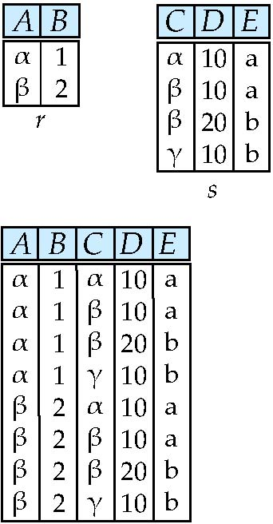
Joining two relations – Cartesian Product
Relations r, s:
r x s:

Slide 18
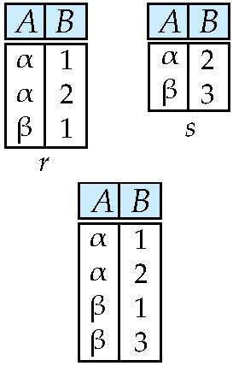
Union of two relations
Relations r, s:
r ∪ s:

Slide 19
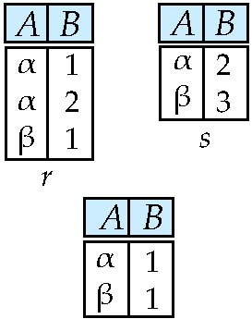
Set difference of two relations
Relations r, s:
r – s:

Slide 20
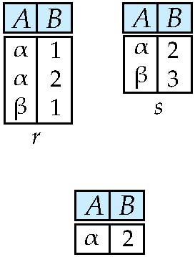
Set Intersection of two relations
Relation r, s:
r ∩ s

Slide 21
Joining two relations – Natural Join
Let r and s be relations on schemas R and S respectively. Then, the “natural join” of relations R and S is a relation on schema R ∪ S obtained as follows:
Consider each pair of tuples t_{r} from r and t_{s} from s.
If t_{r} and t_{s} have the same value on each of the attributes in R ∩ S, add a tuple t to the result, where
t has the same value as t_{r} on r
t has the same value as t_{s} on s

Slide 22
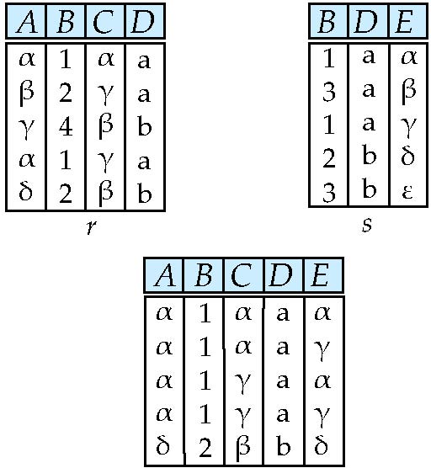
Natural Join Example
Relations r, s:
Natural Join
r s

Slide 23
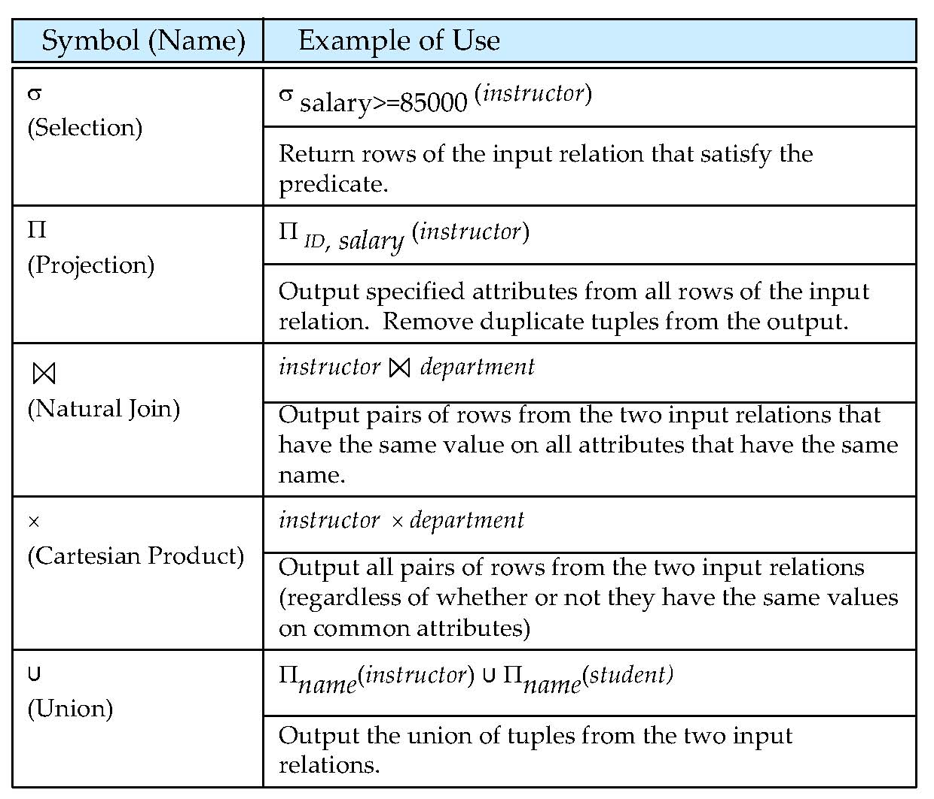
Relational Algebra (details in Ch 6)

Slide 24
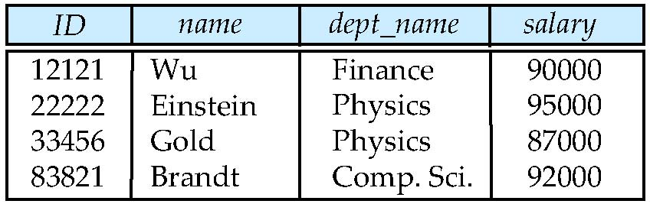
Fig 2.10 Result of query selecting instructor with salary > $85000 (Selection)

Slide 25
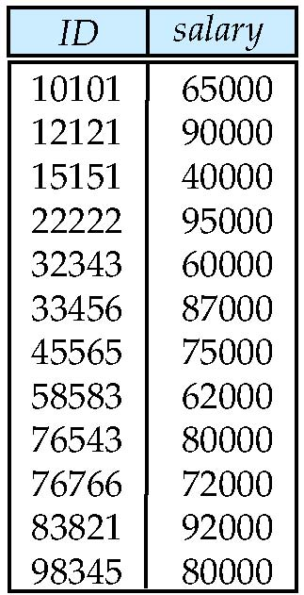
Fig. 2.11 Result of query selecting attributes ID and salary from the instructor relation (Projection)

Slide 26
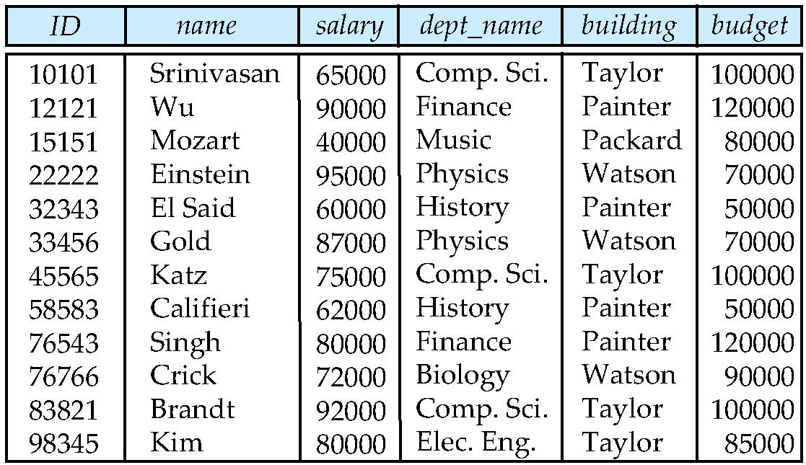
Fig. 2.12 Result of natural join of the instructor and department relations

Slide 27
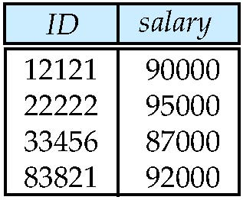
Fig. 2.13 Result of selecting attributes ID and salary of instructor with salary > $85000

Slide 28
End of Chapter 2 in TextB

